Slide 1
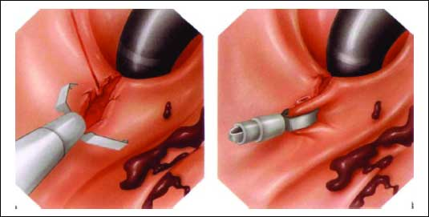
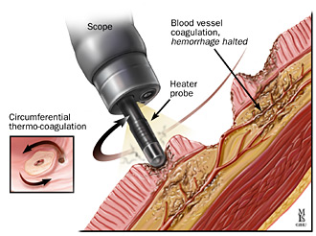
Patient blood management (Intraoperative bleeding management)
By: Nazli Servatian

Slide 2
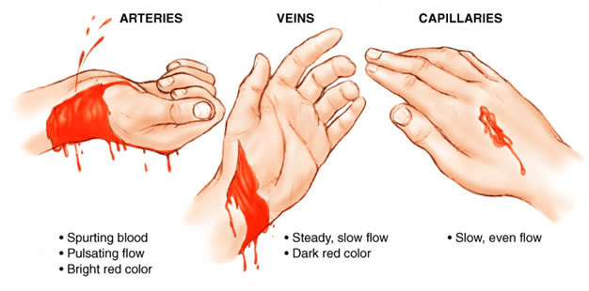
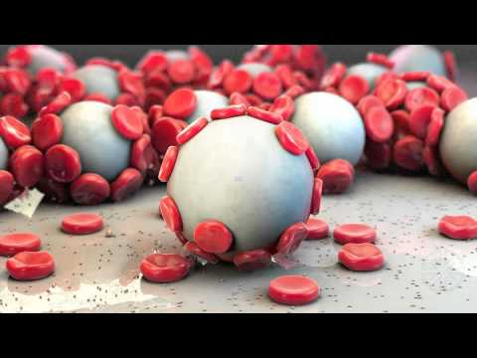
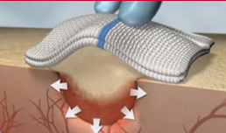
Type of bleeding
Hemostasis
Adjunct hemostatic technique

Slide 3
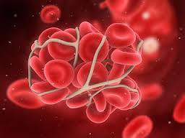
Normal Coagulation Process

Slide 4
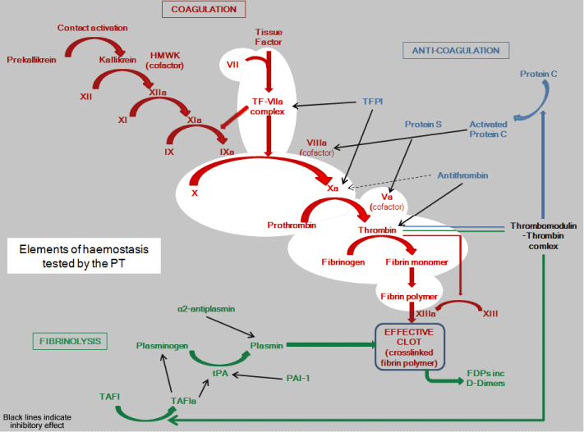

Slide 5
Clinical Implications of Surgical Bleeding
factors that contribute to surgical bleeding
adverse effects of surgical bleeding
importance of managing hemostasis

Slide 6
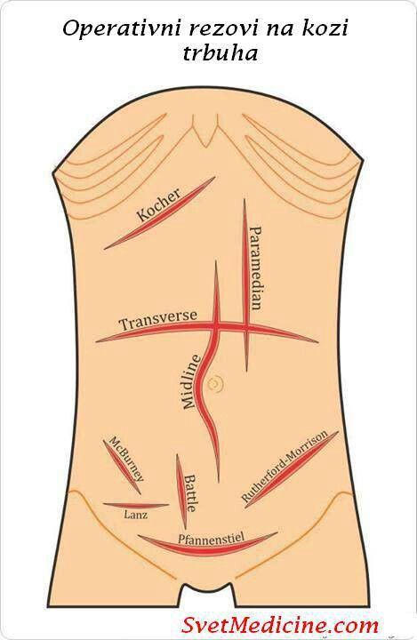
Factors that Contribute to Surgical Bleeding
Patient factors Specific anatomical considerations Medications (eg, anticoagulants) Coagulopathies (Platelet dysfunction or deficiency, Fibrinolytic activity, Coagulation factor deficiencies) Medical conditions Nutritional status | Procedural factors Type of procedure Patient position Surgical incisions Exposed bone (e.g., spinal reconstructive procedures) Large surfaces of exposed capillaries Unseen sources of bleeding Tissues that cannot be sutured or low-pressure suture lines Adhesions stripped during surgery

Slide 7
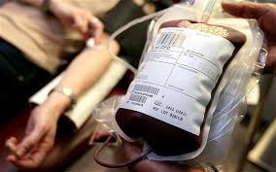
Adverse Effects of Surgical Bleeding
Visual obstruction of the surgical field
Need for blood transfusions
Reduction in core temperature
Thrombocytopenia
Hypovolemic shock
Economic consequences

Slide 8
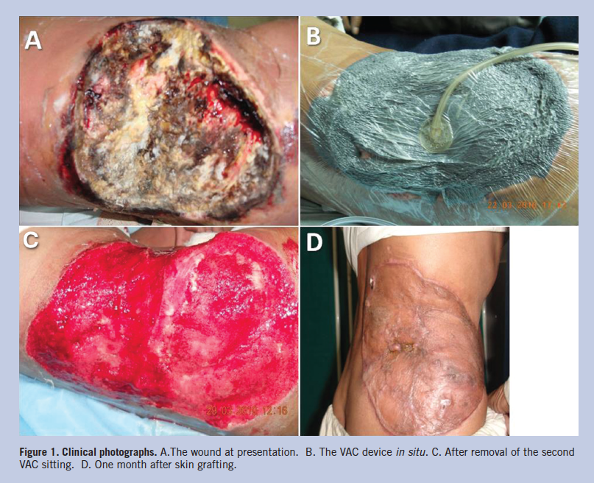
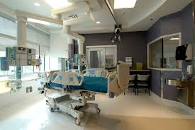
Importance/Benefits of Managing Hemostasis during Surgery

Slide 9
Surgical Hemostasis Techniques
Mechanical methods
Thermal/energy-based methods
Chemical methods
Pharmacological agents
Topical hemostatic agents

Slide 10
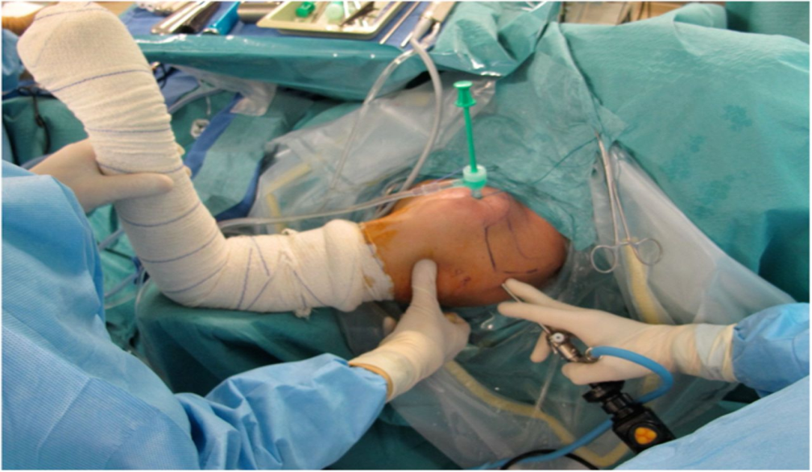
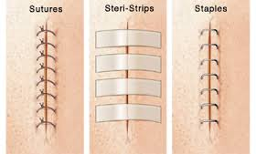
Mechanical Methods
Direct pressure
Fabric pads/gauzes/sponges
Sutures/staples/ligating clips

Slide 11
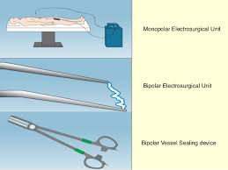
Thermal/Energy-Based Methods
Electro surgery
Monopolar electro surgery
Bipolar electro surgery
Bipolar electro surgery vessel sealing technology
Argon-enhanced coagulation technology
Ultrasonic devices
Lasers

Slide 13
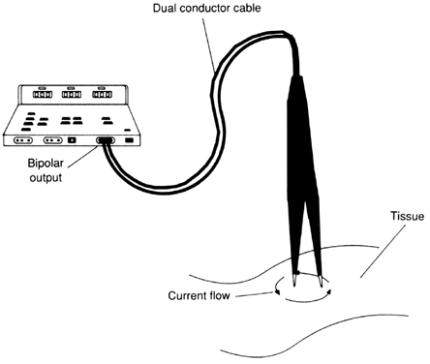

Slide 15
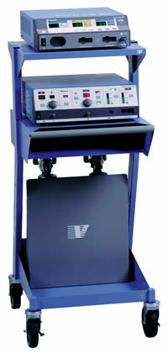
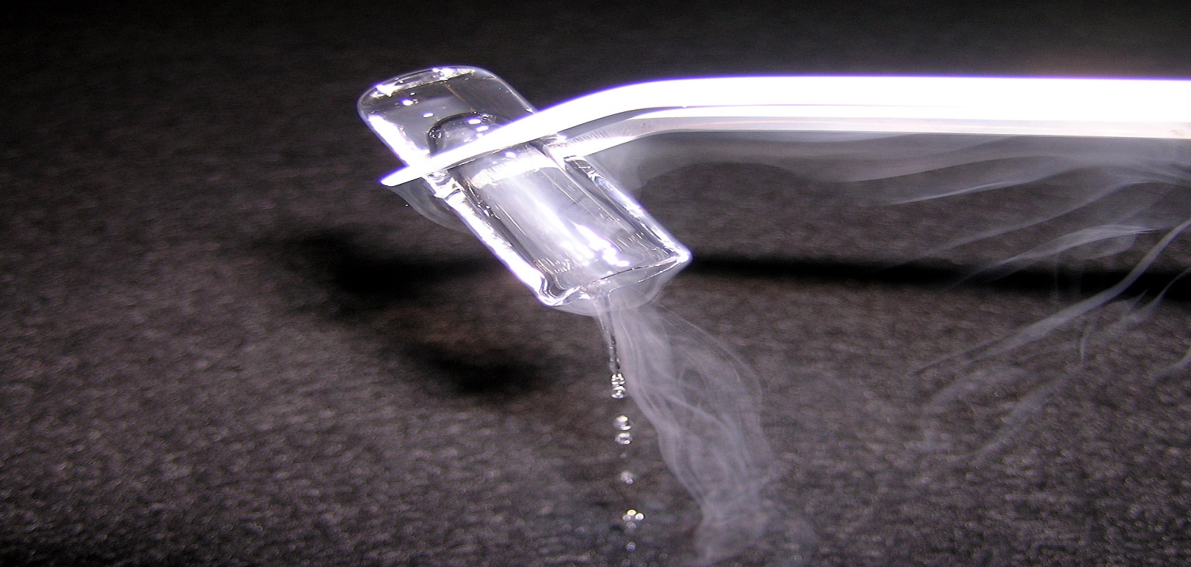
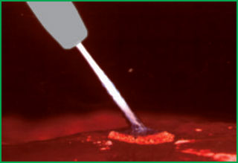

Slide 16
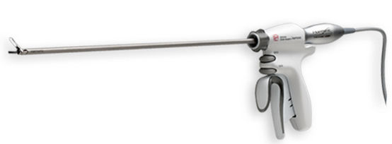

Slide 17
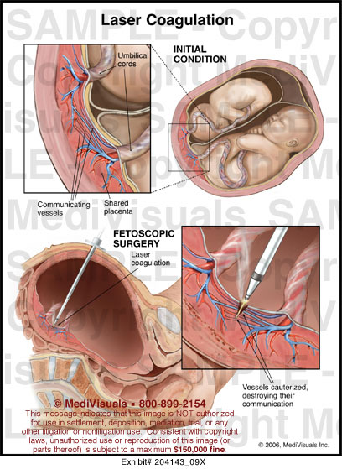

Slide 18
Chemical Methods
Pharmacological agents
Epinephrine
Vitamin K
Desmopressin
Lysine analogues (e.g., aminocaproic acid, tranexamic acid)
Topical hemostatic agents
Passive (i.e., mechanical) agents
Active agents
Flowables
Sealants

Slide 19
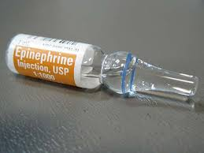
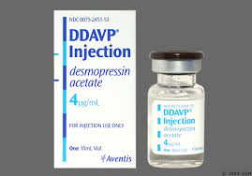
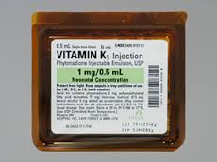
Pharmacological agents
Epinephrine
Vitamin K
Desmopressin
Lysine analogues (e.g., aminocaproic acid, tranexamic acid)

Slide 20
Topical hemostatic agents
Passive (i.e., mechanical) agents
Collagen-based products
Cellulose
Gelatin
Polysaccharide spheres
Active agents
Thrombin products
Flowables
Sealants
Fibrin Sealants
Polyethylene glycol (PEG) polymers
Albumin and glutaraldehyde
Cyanoacrylate

Slide 21
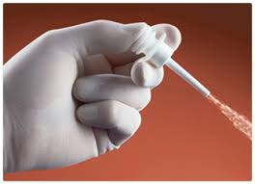
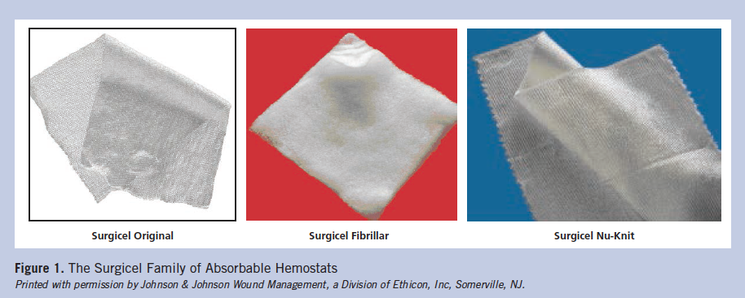
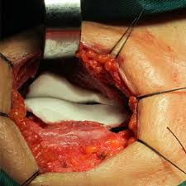
Passive (i.e., mechanical) agents
Collagen-based products
Cellulose
Gelatin
Polysaccharide spheres

Slide 22
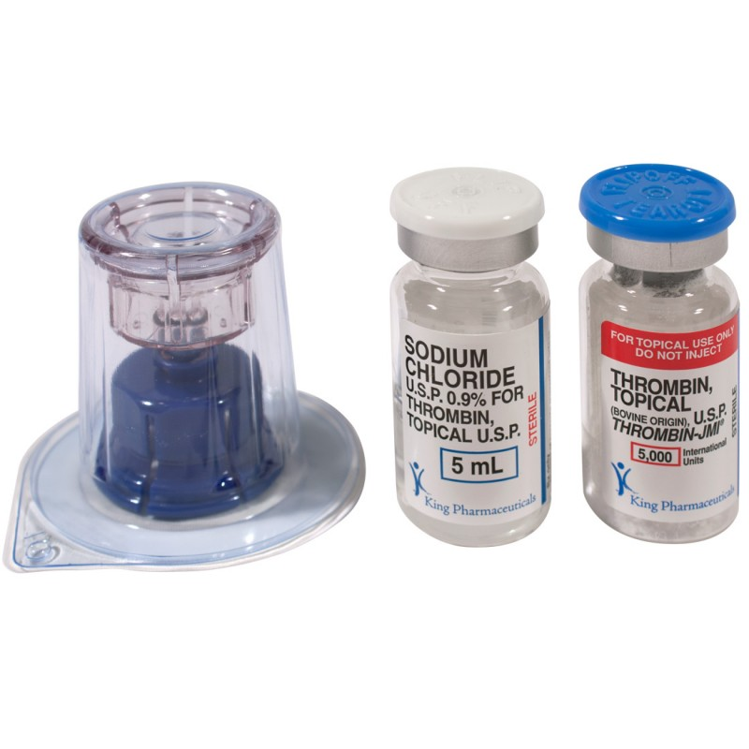
Active agents
Thrombin products
(bovine, pooled human plasma, recombinant
have biological activity at the end of the coagulation cascade
hemostasis within 10 minutes in most patients
available in various forms

Slide 23
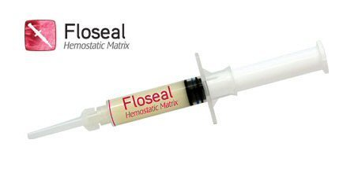
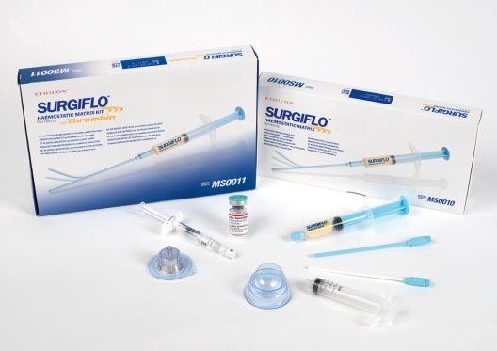
Flowable Hemostatic Agents
combine a passive and active hemostatic agent
blocking blood flow and actively converting fibrinogen
combination of absorbable bovine gelatin particles and pooled human thrombin(FloSeal)
absorbable porcine gelatin particles with any of the three thrombin(Surgiflo)
use in all surgical specialties except ophthalmic surgery
should not be:
used in patients with allergies or known sensitivities to materials of bovine origin
injected or compressed in to blood vessels or tissue
applied in the absence of active blood flow (eg, to clamped or bypassed vessels)
used in combination with blood salvage or cardiopulmonary bypass systems
used for closure of skin incisions

Slide 24
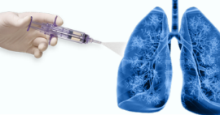
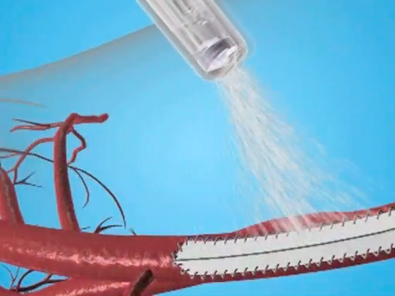
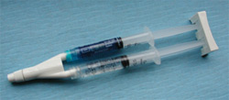
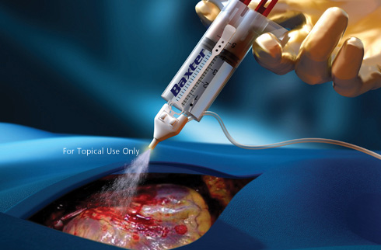
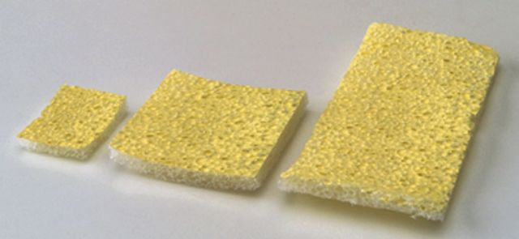
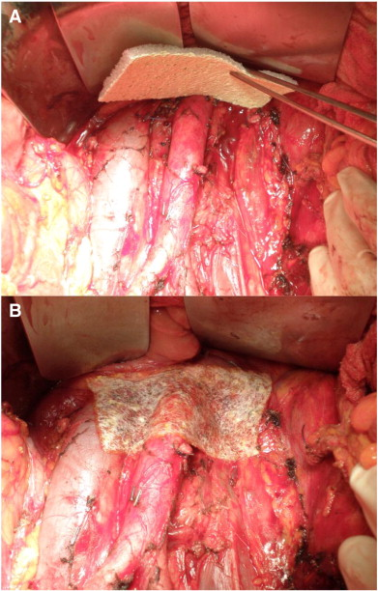
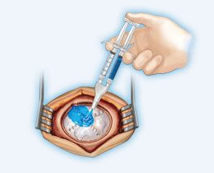
Sealants
Fibrin Sealants
fibrinogen and thrombin
pooled human plasma(Tisseel)
individual human plasma with bovine collagen and bovine thrombin (Vitagel)
pooled human plasma and equine collagen(TachoSil)
coagulopathies who have insufficient fibrinogen OR receiving heparin
skin grafting, dural sealing, bone repair, splenic injuries…
surgeon should clean wounds of antiseptics containing alcohol, iodine, or heavy metal ions
Polyethylene glycol (PEG) polymers
CoSeal
DuraSeal
ProGel
Albumin and glutaraldehyde
10% glutaraldehyde solution and a 45% bovine serum albumin solution
Cyanoacrylate

Slide 25
Before using a chemical hemostatic agent, the surgeon or first assistant should:
determine the appropriateness of using a chemical agent in the area requiring hemostasis
evaluate the wound classification because use of most topical hemostatic agents is contraindicated in contaminated wounds
understand that chemical agents are not intended to act to tamponed or plug a bleeding site
assess the patient for allergies to the agent being considered for use or to the product’s constituents.

Slide 26
The end

