Slide 1
Patient Blood Management
Dr A. Chegini
Anesthesiologist

Slide 2
Use of Allogeneic Blood Conservation Strategies
Shortage of blood products
Transfusion safety
Alternatives to allogeneic red blood cell transfusion

Slide 5
Preoperative period
diagnosis and treatment of nutritional deficiencies (iron, vitamin B12, foliates); optimization of haemostasis;
erythropoietin and/or intravenous iron administration;
predesposit autologous donation (PAD)

Slide 6
Why Autologous Blood Transfusion?
Avoidance of GVHD.
Fully compatible blood.
Avoidance of allo-immunization.
No risk of transfusion transmitted diseases
such as hepatitis, CMV and HIV infection.

Slide 7
Preoperative Autologous Blood Donation
Requirements
personnel licensed to prepare blood products) technical equipment, and premises, as well as a medical indication
absolute contraindications
suspected gastrointestinal infection,
unstable angina pectoris, main trunk stenosis > 50%,
symptomatic aortic valve stenosis,
acute infection with suspected hematogenous dissemination

Slide 8
The hemoglobin concentration before PAD
at least 11.5 ± 0.5 g/dL (BAEK2011)
This threshold is relatively low compared with other countries; for example, in France (Rosencher et al 2008) and Canada (Freedman et al 2008), PAD may only be performed if the hemoglobin value is more than 13 g/dL.

Slide 9
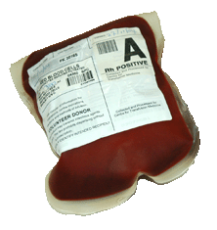
PABD
Hb
Iron supplement
Once a week
No less than 72 hours
Collecting
Testing
Labelling
Notes:
9

Slide 10
PABD

Slide 11
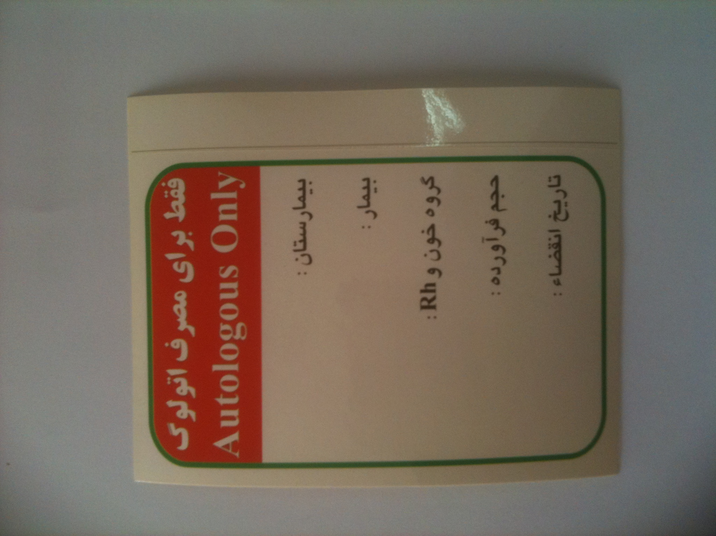

Slide 12
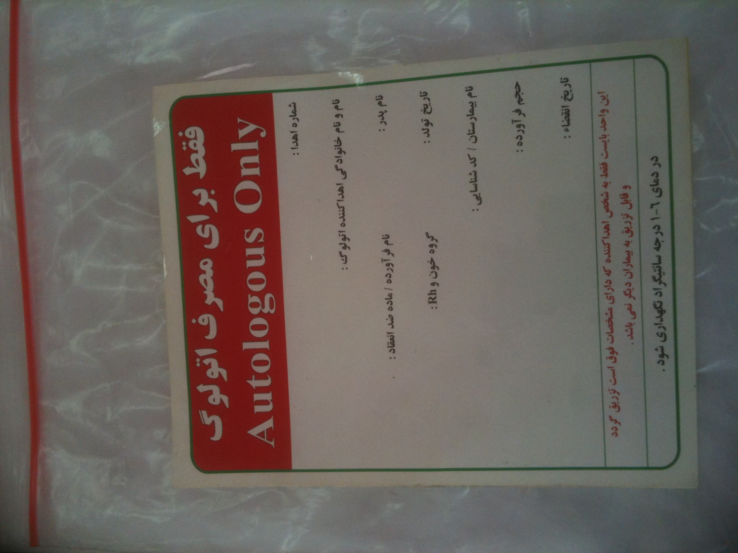

Slide 13
autologous blood donor
HIV-1/2 antibodies,
anti-HCV antibodies,
hepatitis B surface(HBs) antigen
syphilis
Determination blood group (AB0/Rhesus system)
alloantibodies that might cause incompatibility reactions
The same safety standards as allogeneic blood donation

Slide 14
In the context of PBM, the use of PAD is controversial, because most patients become anemic after the donation, which thwarts the first pillar of PBM
PAD reduces the risk of allogeneic RBC transfusion, but increases the risk of receiving a transfusion in the first place.

Slide 15
Intraoperative period
choice of anaesthetic and surgical techniques to reduce bleeding;
patient positioning/hypotention;
correction of hypothermia, acidosis, hypocalcemia, hyperkalemia;
restrictive vs. liberal transfusion (Hb < 7 g/dl vs Hb < 9 g/dl);
thromboelastometry;
pharmacological agents: haemostatic sealants,antifibrinolytics (tranexamicacid, e-aminocaproicacid),procoagulants [1-deamino-8-D-arginine vasopressin (DDAVP), fibrinogen, prothrombin complex concentrate, rFVIIa];
autologous transfusion (intraoperative cell salvage, acute normovolemic haemodilution).

Slide 16
Acute Normovolemic Hemodilution
In the operating theater
in patients with an adequate hematocrit
The withdrawn blood is then retransfused during the operation
To maintain normovolemia, the withdrawn volume is replaced by electrolyte or colloid infusion
Depending on the
baseline hematocrit, two to three 500-mL units of whole blood (each unit containing around 100 mL of a standard stabilizer solution)

Slide 18
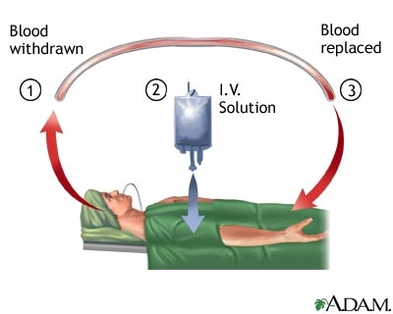

Slide 19
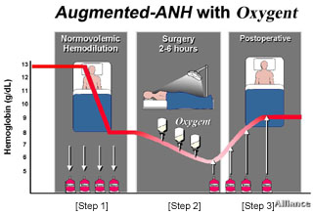

Slide 20
PHYSIOLOGIC CONSIDERATION
Reduction of RBC losses
Increase of perfusion’s tissues
Improved oxygenation
Decrease blood viscosity
Preservation of hemostasis
Notes:
20

Slide 21
Acute Normovolemic Hemodilution
labelling with the patient data
date
Time
stored close to the patient at room temperature for up to 6-8 hours

Slide 22
ANH
ANH related to procedure & volume of blood & target Hct
Documented the manner
Exact monitoring
Aseptic collection
Labelling
Storage (room temperature=8h& refrigirator =24h)
Increase time staying in the operating room
Notes:
22

Slide 23
HOW MUCH VOLUME OF BLOOD DRAWN DURING A.N.H?
V=EBV X (HI-HF)/Hav
EBV=BW X 55-75 ml/kg
Notes:
23

Slide 24
WHAT IS NEEDED FOR A SUCCESSFUL A.N.H PRGRAM?
WORKING AS A TEAM

Slide 25
Acute Normovolemic Hemodilution
To avoid a negative impact on oxygen transport because of the removal of RBCs and the ensuing anemia,
normal cardiovascular function

Slide 26
Effectiveness and use
that lower hematocrit values will be tolerated during ANH if the patient’s cardiovascular function is continuously monitored with advanced hemodynamic monitoring (Oriani et al 2011)
Simple
relatively inexpensive procedure
which is not subject to any technical requirements
The Federal Statistical Office of Germany reports that ANH was used only 1580 times during 2010.

Slide 27
Contraindications to ANH
comprise refusal by the patient
limited cardiopulmonary reserve
tumor surgery
septic surgery
probable bacteremia

Slide 28
Hemodynamic Stability
Monitoring

Slide 29
INVASIVE HEMODYNAMIC MONITORING

Slide 30
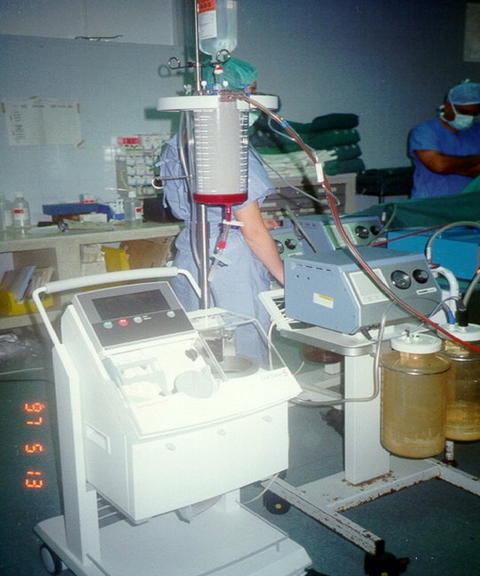
Cell Salvage
Reservoir
The centrifugation system
Technical principles may differ
hematocrit of 50–70%

Slide 35
Cell Salvage
Different washing methods
washing speeds
levels of washing quality to meet the respective clinical situation (e.g., more rapid and greater volume loss in aortic surgery or polytrauma).Hansen and Seyfried (2011).

Slide 37
Cell Salvage
Cell savage is cost-effective if the intraoperative blood loss is large enough and cell salvage can be continued postoperatively
Based on the recommendations of the Association of Anaesthetists of Great Britain and Ireland
cell savage is indicated for blood loss of >1,000 mL or > 20% of the circulating blood volume
rare blood groups
irregular antibodies
preoperative anemia
allogeneic RBC transfusion is refused by the patient (AAGBI 2009).

Slide 38
Indication of cell salvage
major blood loss is expected (orthopaedic or vascular surgery)
for acute emergency operations (BAEK 2011a, Ferraris 2011a, ASATF 2015)
volumetric blood loss (> 1,000 mL) is not appropriate in all cases (pediatric surgery, including pediatric spinal column surgery)

Slide 40
Cell Salvage
salvage of even small blood volumes can help to avoid an allogeneic RBC transfusion in subgroups of patients
Apart from operations with major blood loss, cell salvage can also be used in patients with preexisting anemia to avoid allogeneic RBC transfusions

Slide 41
Cell Salvage
Salvage even of small blood volumes can help to avoid allogeneic RBC transfusions, in particular in children and small-sized adults
Areas of application
Effectiveness
In orthopaedic surgery, cell salvagereduces the relative risk of requiring an allogeneic RBC transfusion by 54% (Carless et al 2010b).

Slide 42
Cell Salvage
No side effects or complications have been reported
surgical disciplines such as obstetrics (Fong et al2007)
vascular surgery (Takagi et al 2007)
pediatric cardiac surgery (Golab et al 2008)
adult cardiac surgery (Wang et al 2009)
neurosurgery(Cataldi et al 1997)

Slide 43
Cell Salvage
In elective operations with a high bleeding risk, cell salvage is a cost-effective measure to avoid allogeneic RBC transfusions, and this does not just apply to orthopaedic surgery.

Slide 44
Contraindications
bacterial contamination
Systemic infection (sepsis)
wound blood is contaminated (in particular with intestinal bacteria)(BAEK 2011a)
The use of cell salvage in obstetrics is controversial because of the risks of fetal cell transfusion and amniotic fluid embolism

Slide 45
the German Medical Association recommends the use of cell salvage in tumor surgery provided the wound blood concentrate is irradiated with 50 Gy before retransfusion (Hansen etal 2002, BAEK 2011a).

Slide 46
POINT OF CARE

Slide 48
Thromboelastometry (Rotem® System)
point-of-care coagulation (POC) method for hemostasis testing
rapid assessment of the three aspects of coagulation:
clot strength
thrombin generation
clot stability
gold standard for diagnosis of premature dissolution of the clot (hyperfibrinolysis)

Slide 50
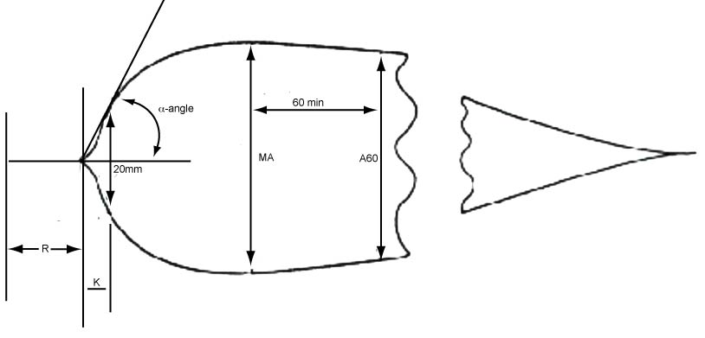
TEG

Slide 52
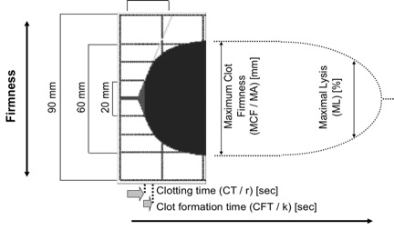
ROTEM

Slide 57
R value on the TEG : the time it takes for clot formation to start, it is a reflection of coagulation factor activity. Coagulation factors are essentially enzymes that drive clot formation. Thus, a prolonged R time should be treated with plasma.
The alpha angle : the thrombin burst and conversion of fibrinogen to fibrin. Thus, a depressed alpha angle should be treated with either cryoprecipitate or large volumes of plasma.
80% of the MA is derived from platelet function whereas the remaining 20% is derived from fibrin. Thus, a depressed MA is better treated with platelet transfusion or medications that improve platelet function, such as DDAVP.
An elevated EPL or LY30 suggests fibrinolysis and may be treated with an antifibrinolytic, such as tranexamic acid or aminocaproic acid, in the appropriate clinical setting

Slide 60
Probable causes → Common treatments
Vessel injury → Repair
Von Willebrand Factor deficiency → DDAVP (desmopressin)
Presence of platelet inhibitor → Run PlateletMappingTM

Slide 62
Patient status: bleeding
Factor deficiency
Platelet deficiency

Slide 63
Probable causes:
Residual heparin
Factor deficiency

Slide 64
Probable cause: fibrinogen deficiency

Slide 65
Probable causes:
Low platelet count
Low platelet function

Slide 66
Probable causes:
Factor deficiency
Low platelet count
Low platelet function

Slide 67
Point of care
Measurement of viscoelastisity
The sonoclot analyzer
PFA-100
Platelet function test
Hemostatus

Slide 68
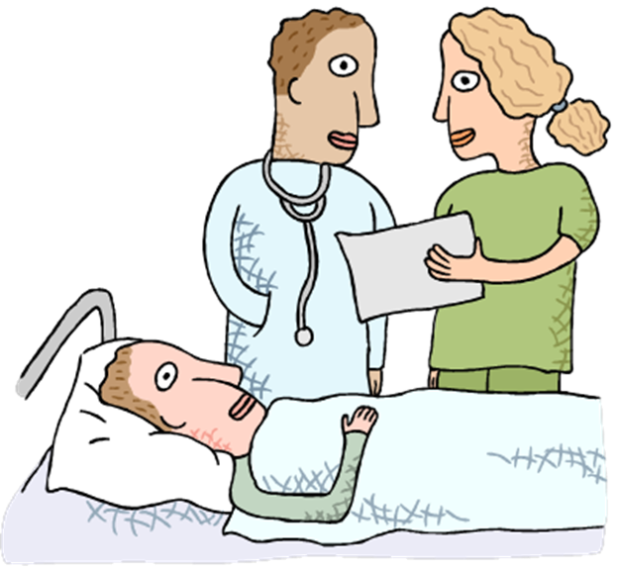
Pharmacologic tools to reduce bleeding in surgery
Hemostatic agents
Hemostatic agents
rFVII
Desmopressin
Fibrinogen
Antifibrinolytic agents
tranexamic acid
epsilon aminocaproic acid (EACA)
serine protease inhibitor (eg, aprotinin

Slide 75
Artificial Oxygen Carriers
Perfluorocarbon (PFC) emulsions are the most studied products that can boost oxygen delivery by increasing the amount of dissolved oxygen
Fluosol-DA
Oxygent
Perftoran

Slide 76
Artificial Oxygen Carriers
Three products
HemAssist (Baxter, Deerfield, IL)
Hemopure (Biopure, Cambridge, MA; now, OPK Biotech,Cambridge, MA)
PolyHeme (Northfield, Evanston,IL) HBOCs.
[HemAssist (also known as diaspirin cross-linkedHgb or DCLHb) was produced from outdated human allogeneicblood units and had an Hgb concentration of 10 g/dL.]

Slide 77
Postoperative period
postoperative cell salvage;
ESA and/or iv iron
Increase of inhaled oxygen content
maintenance of adequate intravascular
volume and optimization of cardiac performance augments oxygen delivery
Control of fever or shivering and provision of substantial bed rest

